Slide 1

International student recruitment

Slide 2
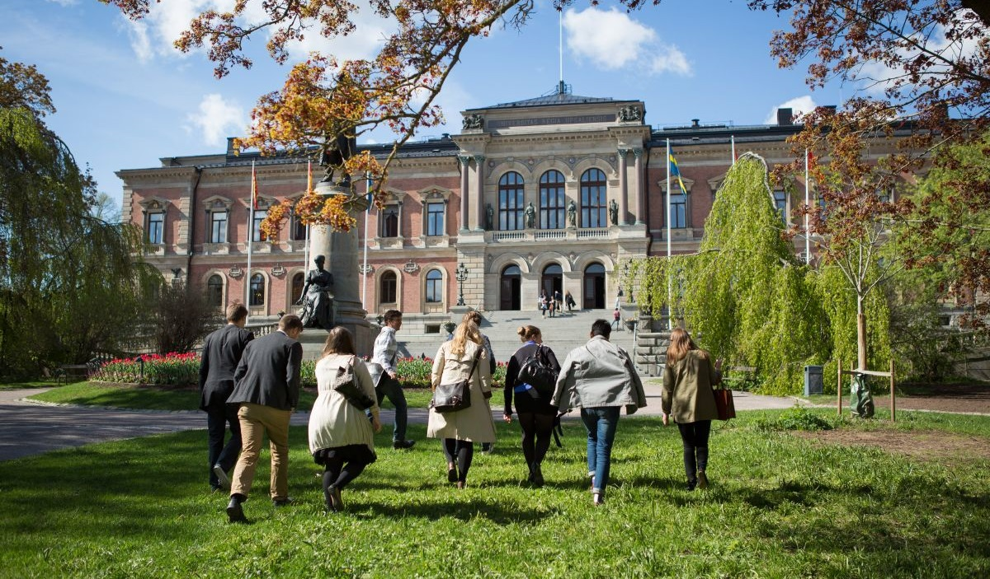
Lina Solander, International Officer

Slide 3
International recruitment at UU
Started in 2011, when tuition fees were introduced for non-EU student.
Small team, with small resources to begin with.
Integrated team, working with both recruitment and student support.

Slide 4
International programmes
Around 100 international Master’s programmes, including all specializations.
4 international Bachelor’s programmes.
National application portal: www.universityadmissions.se
Admission only to the fall semesters, application deadline January 15 every year.

Slide 5
Progress so far
Constant increase in applicants and admitted students per year, around 10-25 % per year.
Fall 2020: 8500 first-hand applicants, 3250 admitted students. Almost 700 new fee-paying students who paid their tuition fee, plus 3-400 new EU students.

Slide 6
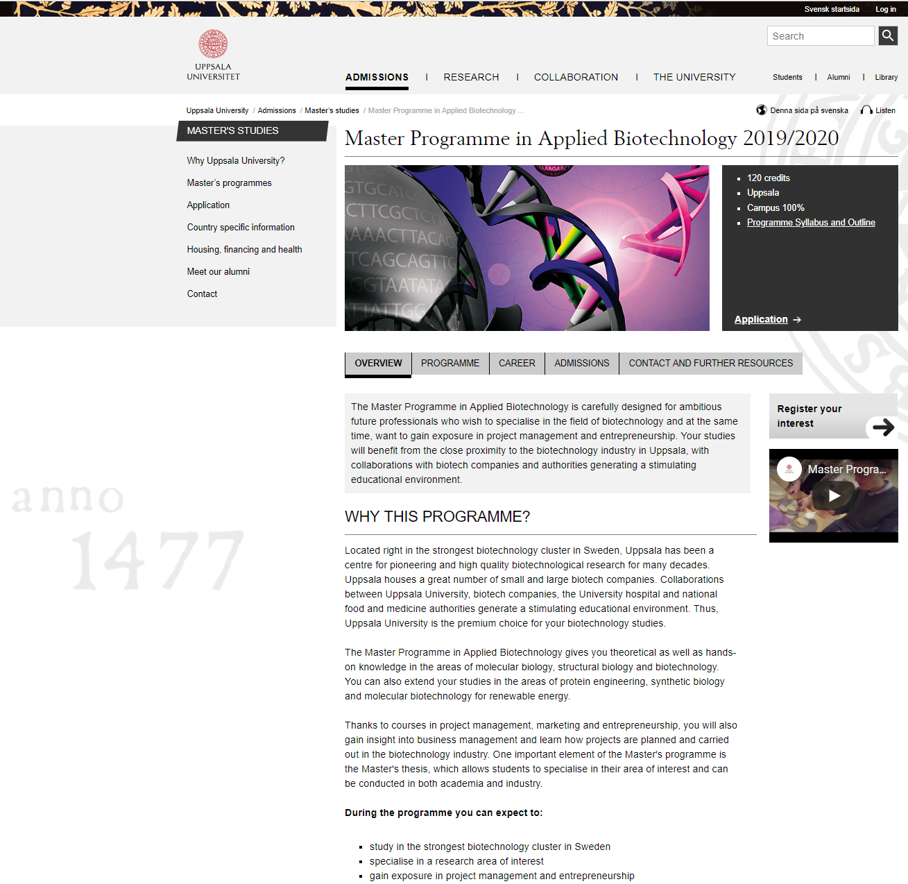

Create interest
Mainly through our website and Google AdWords.
We also have around 10 agents and work with one portal website.

Slide 7
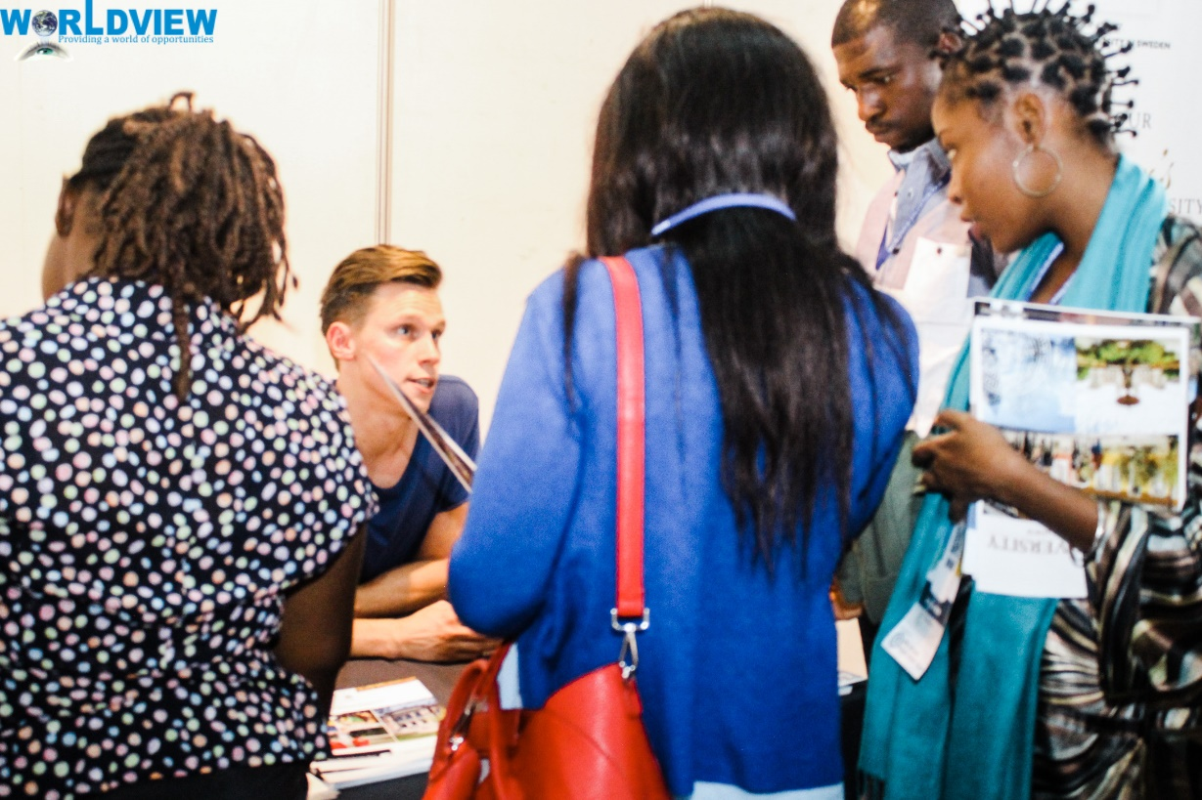
Recruitment fairs
Conservative strategy: We travel to a select number of countries every year. Countries are selected mainly on the basis of applicant and admission data from previous year. China and India our biggest countries.
Fairs have a documented low return on investment, but can of course be used for other purposes.

Slide 8
Applicant support
Cost effective
High level of service – correct and quick.
One stop shop – we want to make sure applicants and admitted students get the correct information.
Personal touch – they talk to the same people from interest-applicant-admitted-arrived.
Make sure applicants submit a correct application – we still lose too many applicants every year due to incorrect applications.
Notes:
Uppsala University is the oldest Nordic university – founded in 1477. It ranks among the best universities in Northern Europe and top 100 in the world.
Archbishop Jakob Ulvsson was the initator behind its establishment. In the beginning, education consisted primarily of lectures in philosophy, law and theology; there was no teaching in natural sciences or engineering.
The university rose to significance during the rise of Sweden as a great power at the end of the 16th century. Uppsala also has an important historical place in Swedish national culture, identity and for the Swedish establishment: in historiography, literature, politics, and music. Many aspects of Swedish academic culture in general, such as the white student cap, originated in Uppsala. It shares some peculiarities, such as the student nation system, with Lund University and the University of Helsinki.
Sen kan man säga något om att det här är sommar/vår för att anspela på nästa bild.

Slide 9
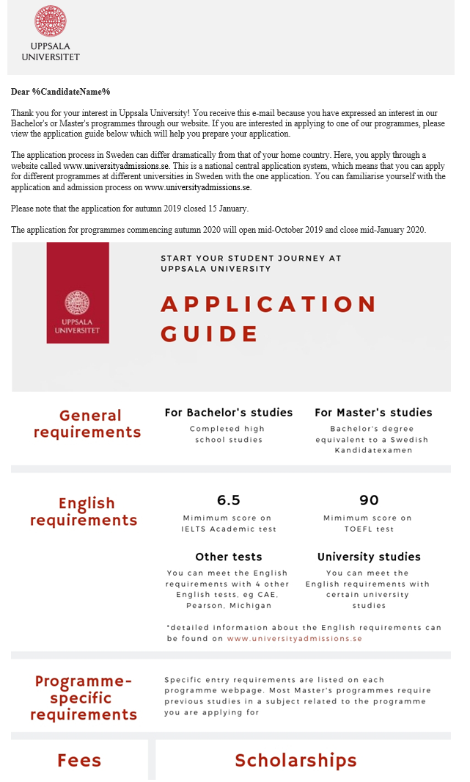
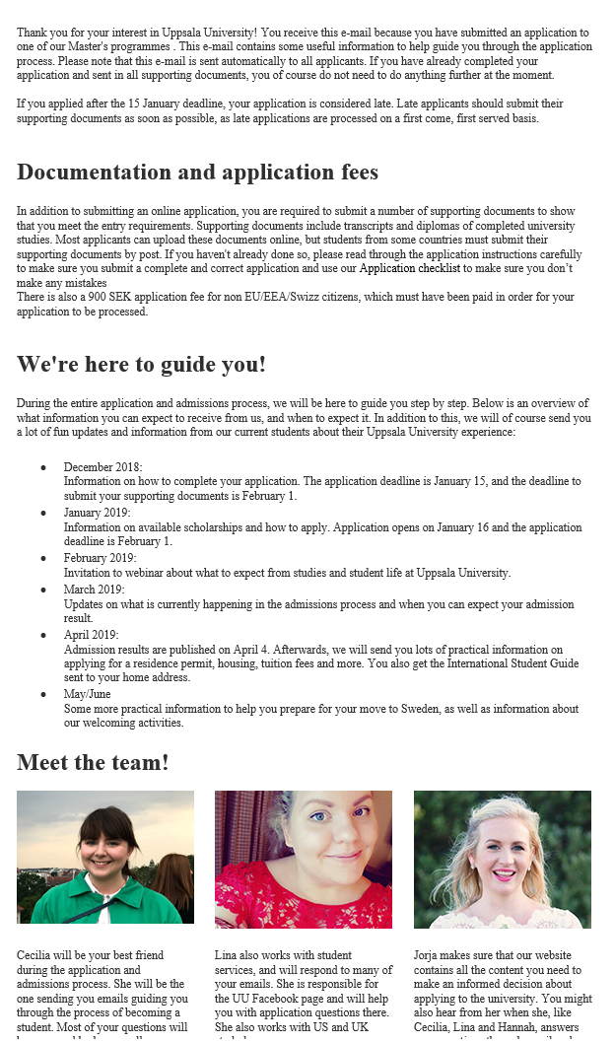
During and after the application
We send out many emails to make sure applicants submit a correct application on time:

Slide 10
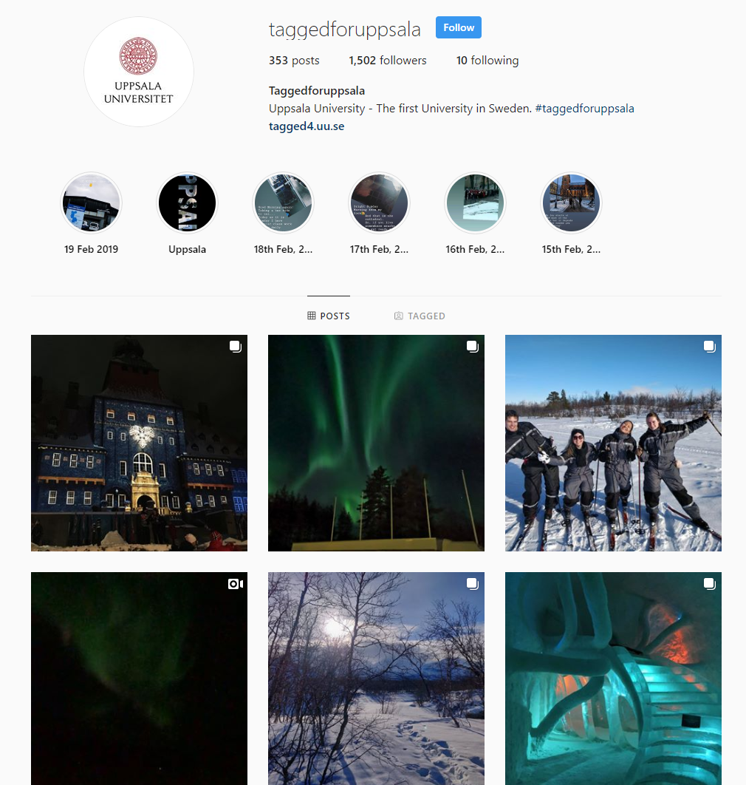
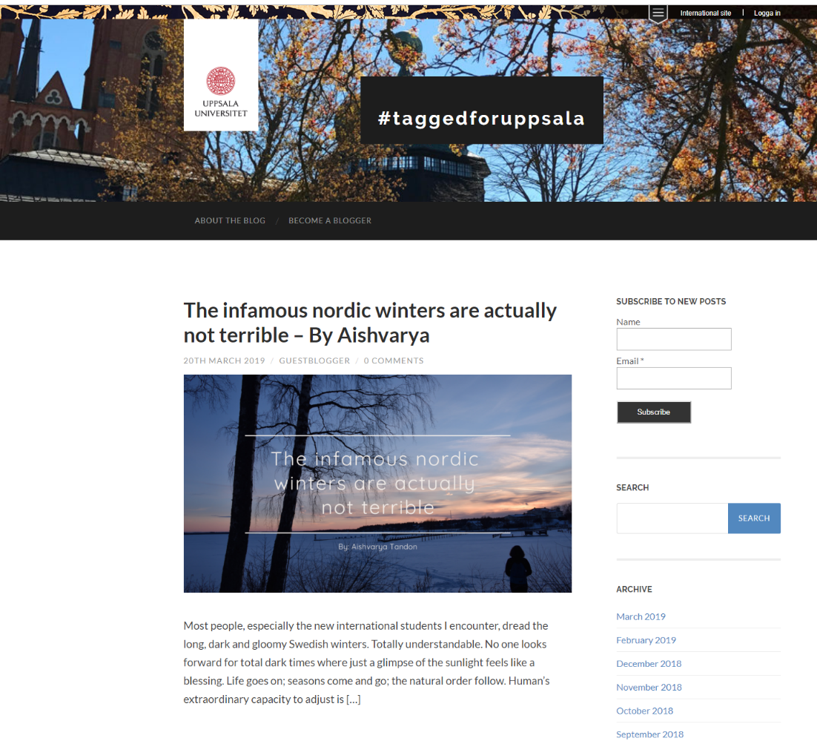
Blog and Instagram
Made by students, for students:

Slide 11
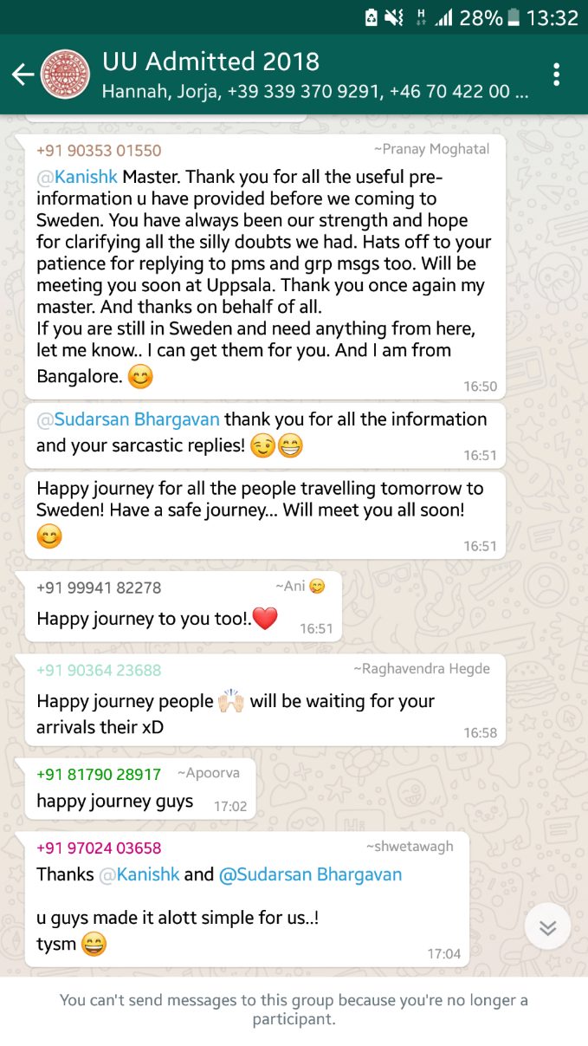
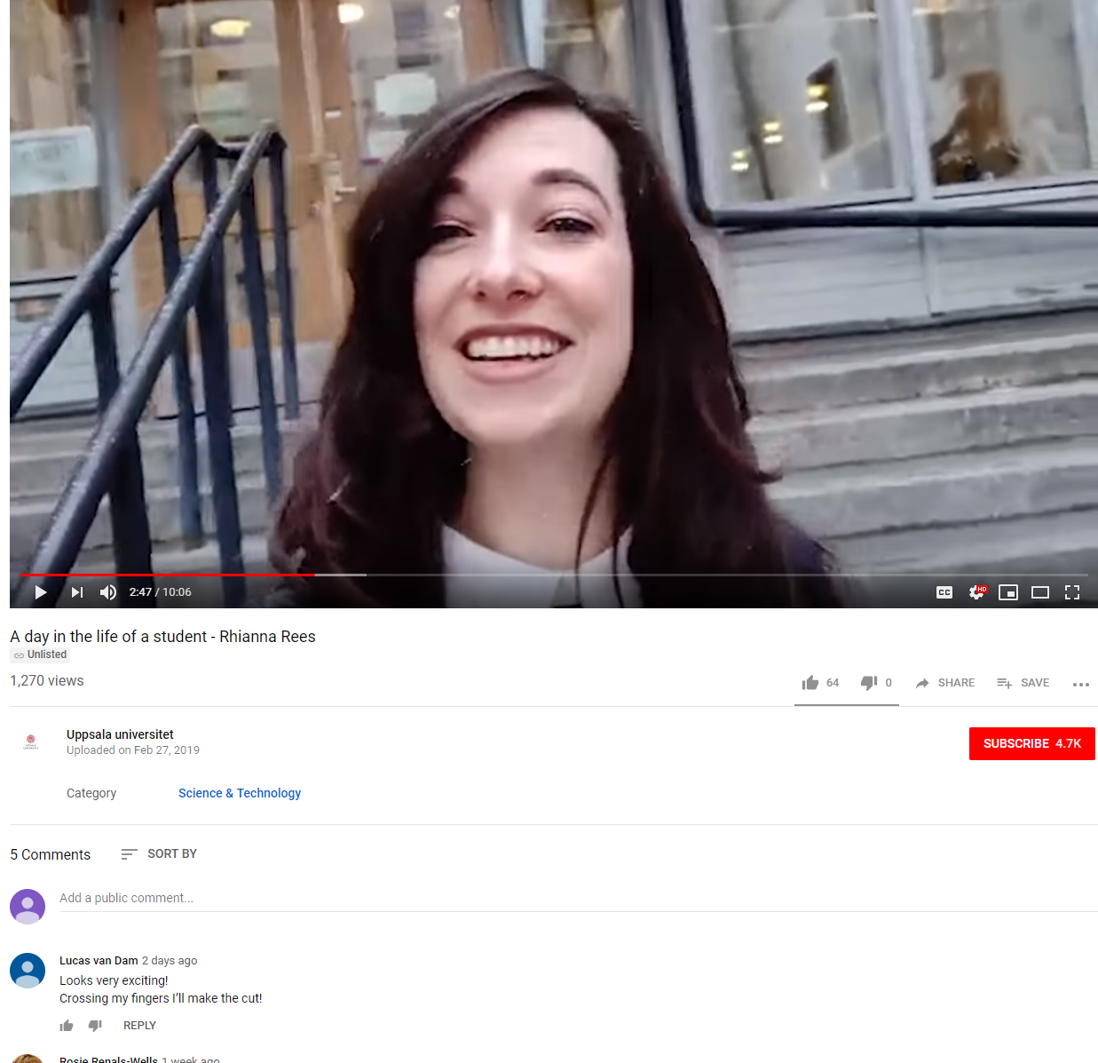
Information from current students
Through webinars, chat groups and Youtube videos:

Slide 12
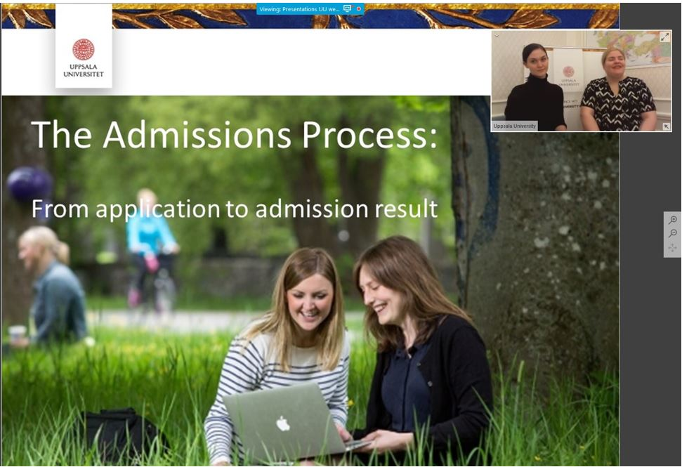
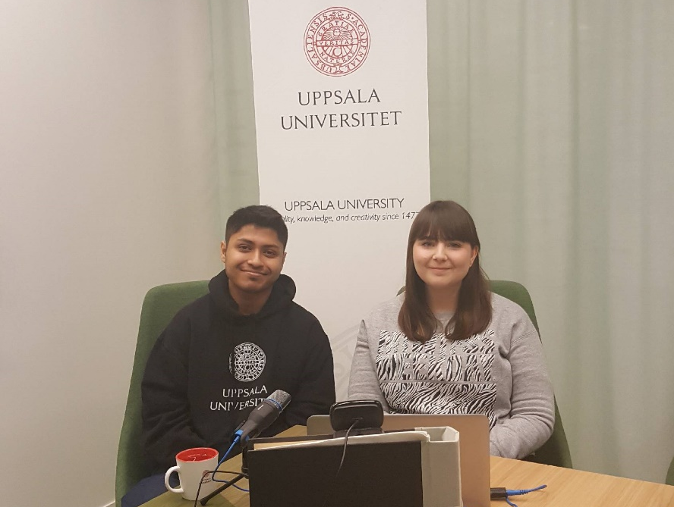
Webinars
Online presentation with video. Those who cannot attend get a recording sent to them. Live Q&A.
For our focus countries, we do country specific webinars with a current student
from their country.

Slide 13
What we offer to students
Health insurance to fee-paying students and exchange students.
Housing guarantee for fee-paying students and exchange students through our
Housing Office.
Some scholarships which cover the tuition fee. The Swedish government also has a scholarship programme for selected countries with scholarships that cover tuition and living expenses.
Support with practical things like applying for a Swedish residence permit.
For students after they have arrived: Student Health Services, Language Workshop, beginner’s courses in Swedish, workshops and events for career support.

Slide 14
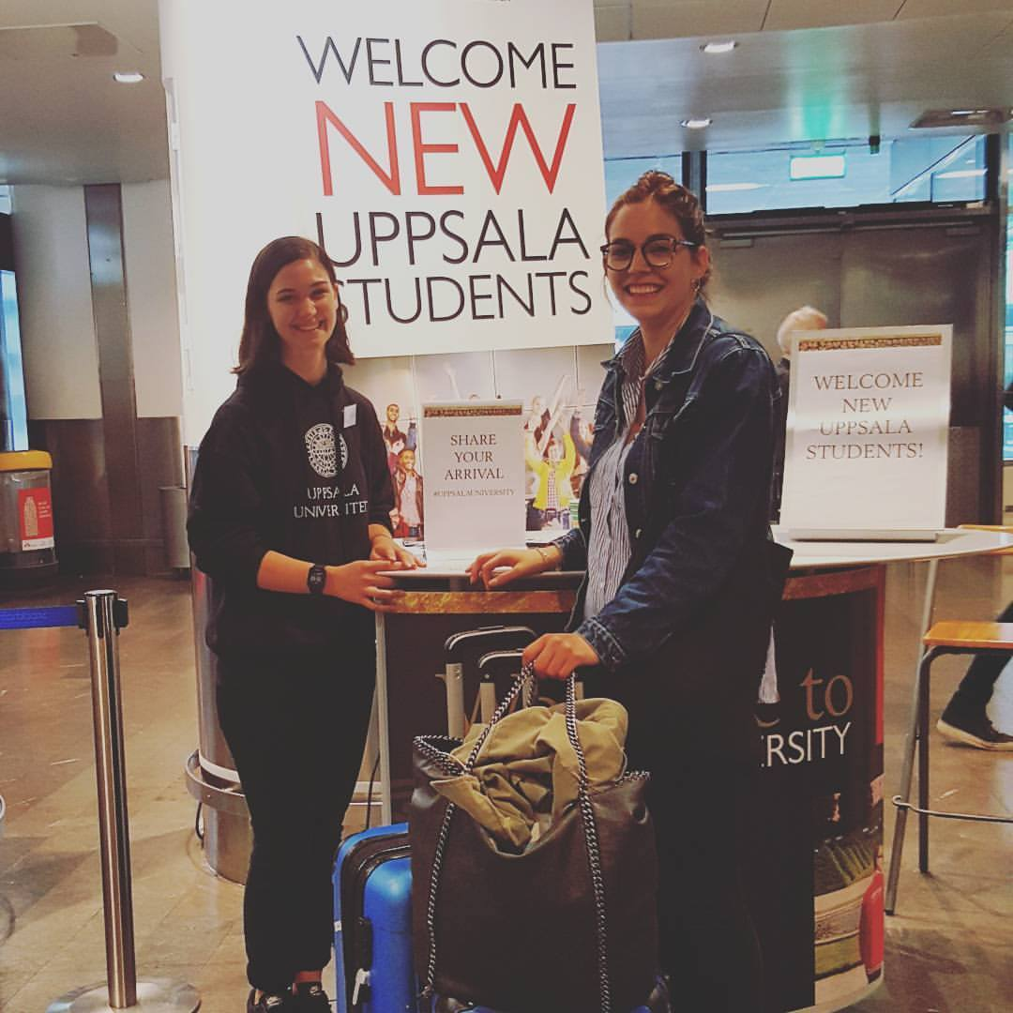
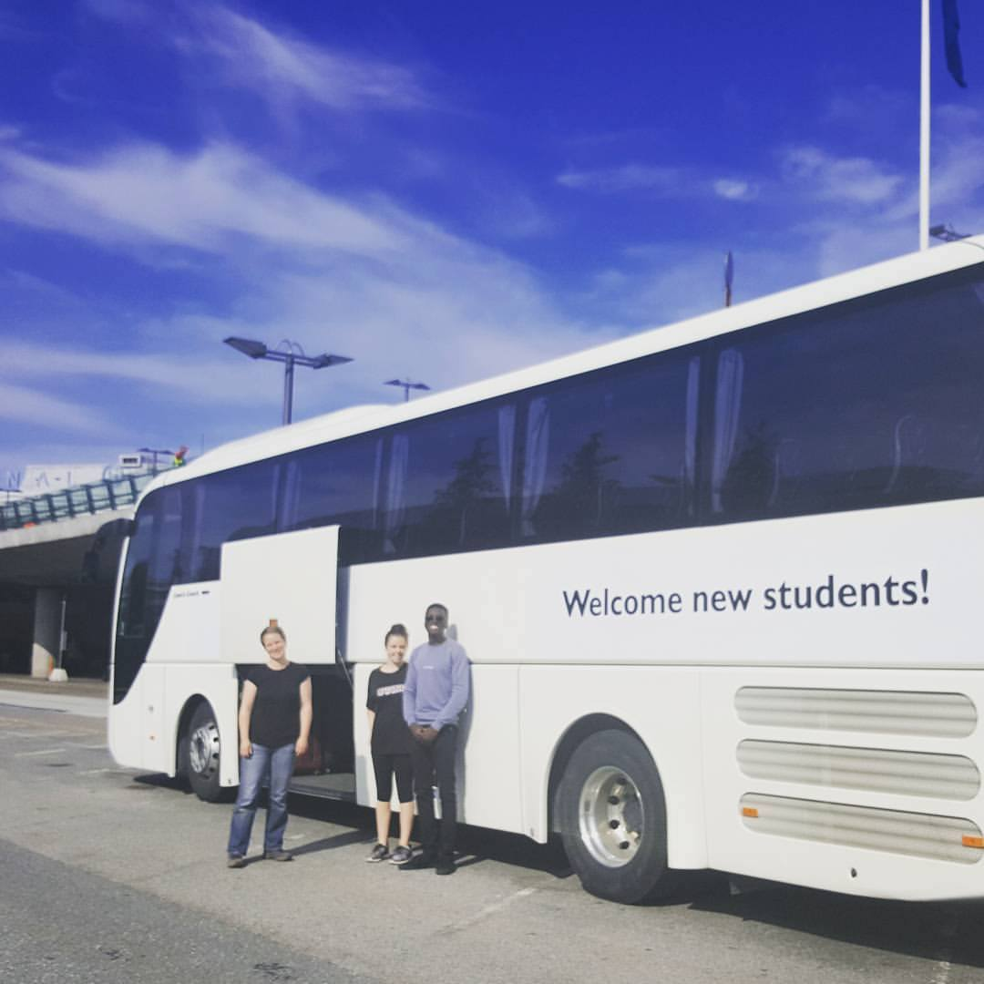
Welcoming of new students
Arrival Days at Arlanda Airport.
Shuttle service to Uppsala, to welcome centre were they can pick up keys and get important informaton. Shuttle service from welcome centre to their housing.

Slide 15
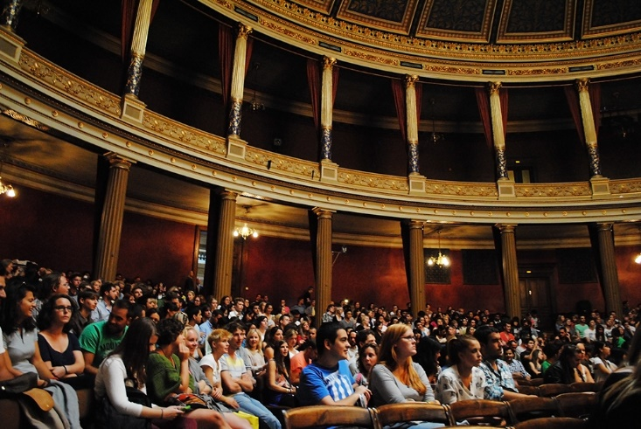
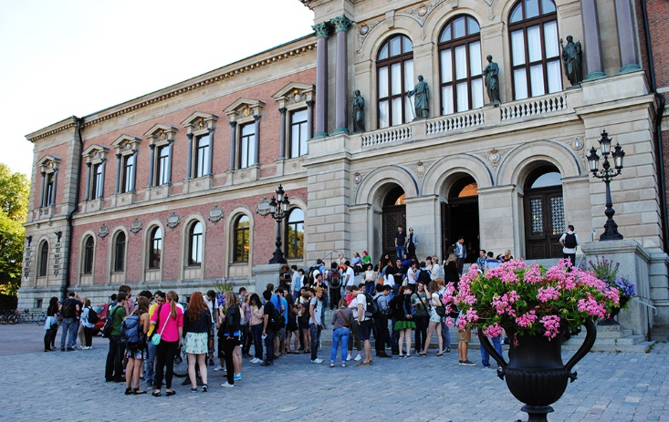
Welcoming of new students
Welcome Reception in University Main Building – welcome speech by University Vice Chancellor.
Information sessions and workshops to help them prepare.

Slide 16

Buddy programme
Run by the Student Unions
Matches a current student to be a buddy to a new international student

Slide 17
Challenges
Housing – we offer a housing guarantee for fee-paying students but not EU students. We have no housing for students bringing family.
Residence permits – slow process for students from certain countries.
Preparation and language skills – Some students are poorly prepared for university studies in Sweden.
Manage expectations – Sweden is expensive, cold and dark in the winter, Swedes may be difficult to make friends with in the beginning.
Notes:
Uppsala University is the oldest Nordic university – founded in 1477. It ranks among the best universities in Northern Europe and top 100 in the world.
Archbishop Jakob Ulvsson was the initator behind its establishment. In the beginning, education consisted primarily of lectures in philosophy, law and theology; there was no teaching in natural sciences or engineering.
The university rose to significance during the rise of Sweden as a great power at the end of the 16th century. Uppsala also has an important historical place in Swedish national culture, identity and for the Swedish establishment: in historiography, literature, politics, and music. Many aspects of Swedish academic culture in general, such as the white student cap, originated in Uppsala. It shares some peculiarities, such as the student nation system, with Lund University and the University of Helsinki.
Sen kan man säga något om att det här är sommar/vår för att anspela på nästa bild.

Slide 18
Key words for our team
Friendly and approachable.
Always correct information, not trying to ”sell” an education at any cost.
We don’t need more applicants, but we do need the right applicants.

Slide 19
Plans for the future
Finding the best applicants.
More evaluation: Calculating the return on investment on activites.
Finding more ways for applicants to get in touch with current students.

Slide 20
Questions?
lina.solander@uadm.uu.se

